Slide 1
What’s inside your network?
Security Log Visualization with a Correlation Engine:
Chris Kubecka
Security-evangelist.eu
All are welcome in the House of Bytes
English Language Presentation
Notes:
Presentation date and time:
29/12/2011 13:00 CET
Good afternoon, guten tag, goedemiddag, добрый день, 下午好/xiàwǔ hǎo, purda vida
My Name is Chris Kubecka
Mien name ist Chris Kübecka
Mijn naam is Chris Kubecka
меня зовут Крис Kбyиka
我的名字叫 克里斯
mi nombre es Cris Kubeka

Slide 2
Questions for 28C3
Have you ever been a network engineer, analyst, or administrator?
Have you ever read network, application or security logs?
Have you ever monitored a network or investigated security incidents?
Are you familiar with a correlation engine?
Have you ever wanted to know what a compromise or attack looks like?
Notes:
Preguntas para la 28C3 audiencia
¿Ha trabajado un ingeniero de redes, analista de administrador?
¿Ha leído una red, la computadora o los registros de datos de seguridad?
¿Se han monitoreado de red o investigar los incidentes de seguridad para las computadores?
¿Está familiarizado con las aplicaciones informáticas de correlación del motor?

Slide 3
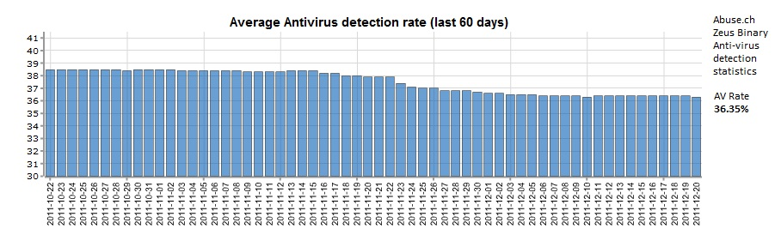
Network Security Challenges
Too many logs from too many different types of sources
Too many different security consoles to monitor and learn
Too time consuming or impossible to correlate
End Point and network protection limited against 0day/newer malware or polymorphic malicious code

Slide 4
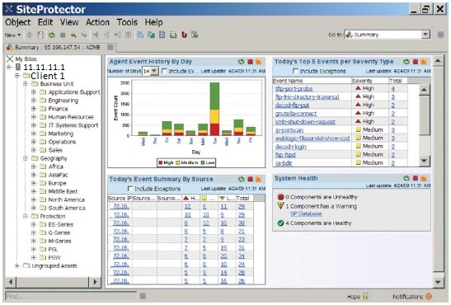
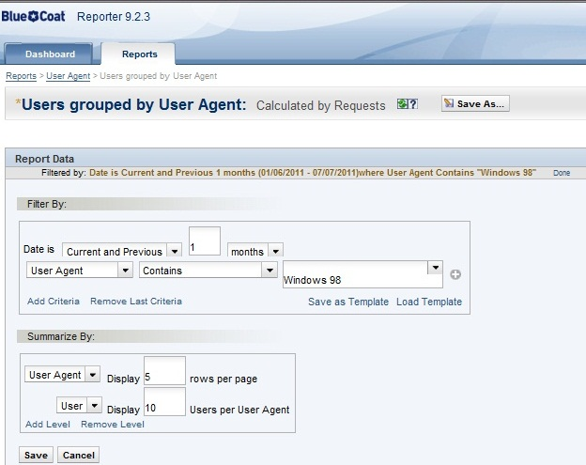
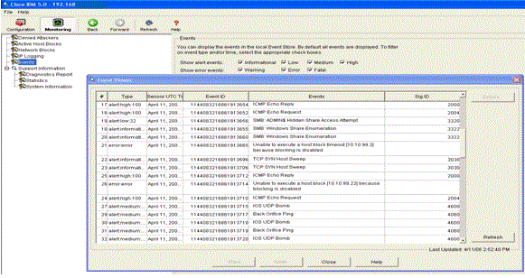
Logs and Consoles
Firewall
Web Proxy server
DNS server
Host intrusion detection/prevention
Network intrusion detection/prevention
Server security or application log
Web server
Email server
End point Anti-virus
Badge entries and exit with identification
& many more.....

Slide 5
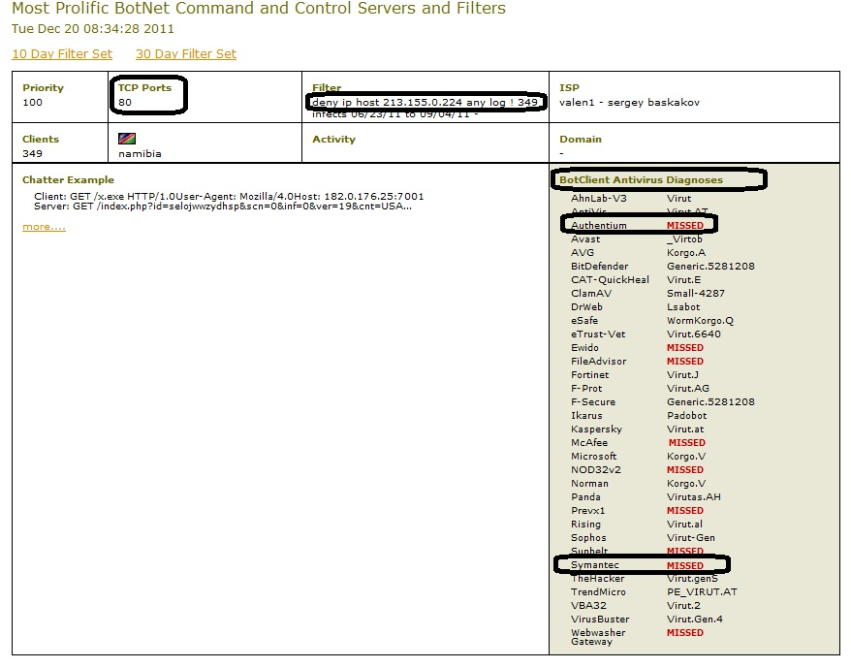
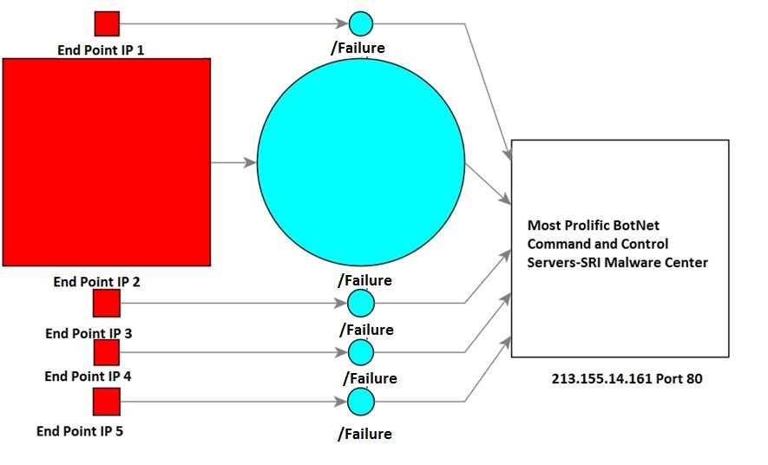
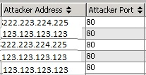
Challenge solved!
Can be used to investigate and monitor multiple security controls in one location in a readable format and console.
Normalizes network, application or security logs into one format and location.
Categorizes the logs into severity, event count, access type, violation type, asset type, etc... Of multiple types of logs.
Can view the correlation of logged events from multiple sources.

Slide 6
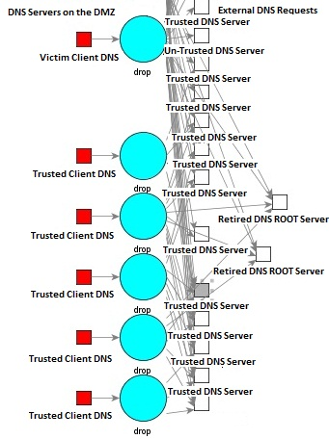
Unusual DNS Activity
Attempting to contact old DNS root servers
Attempting to contact a suspicious Un-trusted external DNSIP address

Slide 7
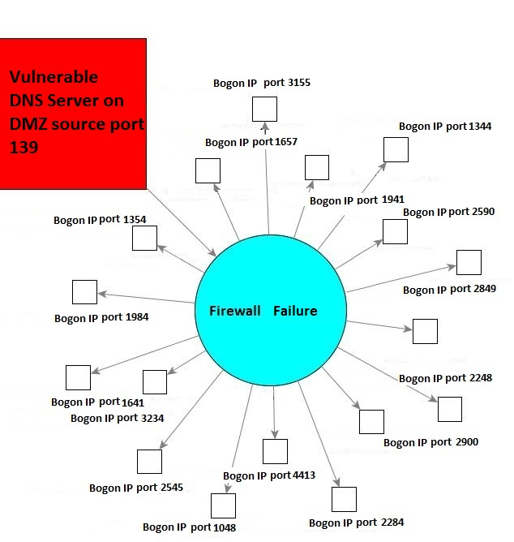
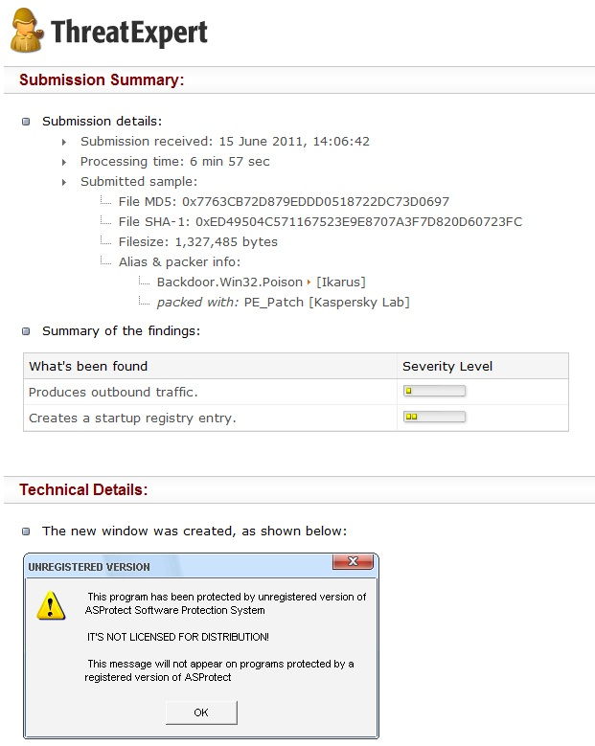
Unusual DNS Activity
The external IP had advisories for a Trojan/keylogger
Had port 139 open as a DMZ DNS server
Attempting to contact a Bogon/unallocated IP network
Trying to communicate outbound using a suspect port combination

Slide 8
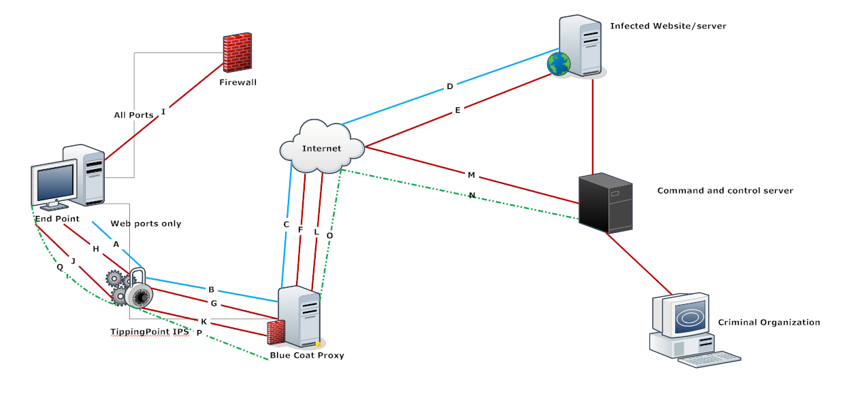
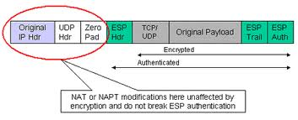
  Bypassing Deep Packet Inspection via Encryption
  If traffic is encrypted, only the basic routing information (packet header) can be monitored and processed by an IPS or an application firewall unless the encryption is broken
  Only the end host and the destination have the key to the encrypted session.
  If the encrypted packet contains advanced routing an IPS nor a application firewall can effectively monitor the traffic

Slide 9
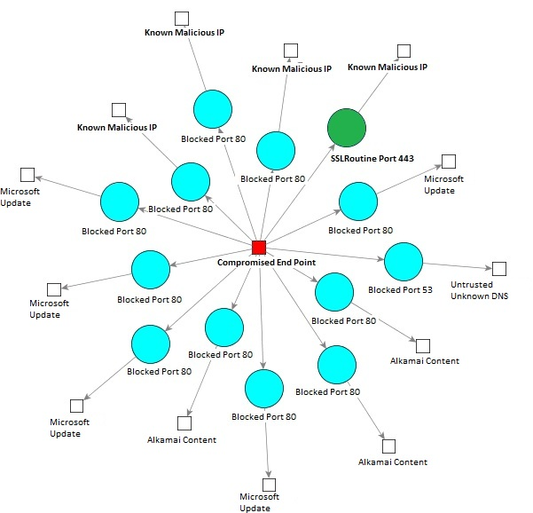
Encrypted covert communications channel
Clear text Outbound traffic was detected and blocked by web proxy and web application firewalls and network intrusion prevention security controls via deep packet inspection
Once outbound packets were encrypted communications were able to traverse the network

Slide 10
DDoS South Korea July/August 2009
Targeted
Planned
Estimates are from 1100-166,000 computers took part in the attack globally
Controlled bot armies via W32.Dozer and other malicious code
Used high bandwidth networks

Slide 11
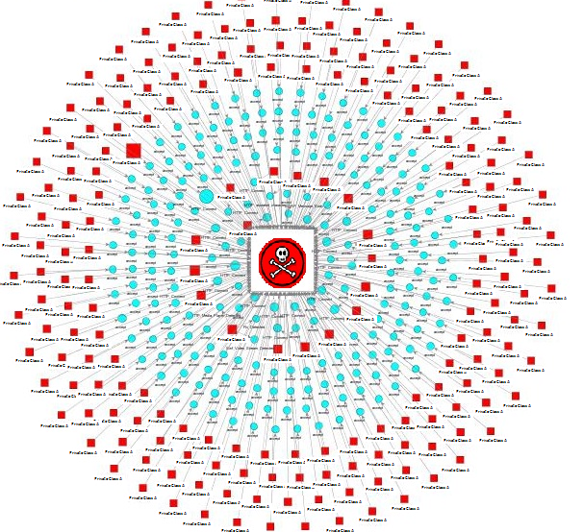
DDoS South Korea 2009
The client was an EU financial institution significantly owned by a European government
Filtered the traffic by the target IP addresses
Monitored traffic included all perimeter firewalls and network and host intrusion systems
About 200 of the end point assets participated in the attack

Slide 12
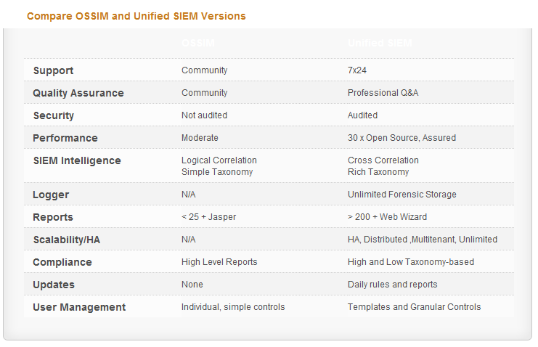
Correlation Engines
ArcSight SIEM
Tenable Log Correlation Engine 3.6
RSA
NitroView ACE
Alien Vault OSSIM which can be used for ANY type of log and sensor data

Slide 13
Closing
One location, centralized for security logs in real-time can enable faster detection, monitoring and investigations
All information in a readable, standardized format allows detection rules to go across the entire network not dependent on vendors or versions but the type of technology
Can be used to test network security, if an attack or exploit can be detected and what if any logs will be produced

Slide 14
Questions?

Slide 15
Websites/Organizations
Abuse.ch
SRI Malware Center - http://mtc.sri.com/
VirusTotal - http://www.virustotal.com/
Robtex – http://www.robtex.com/
Hurricane Electric - http://www.he.net
CleanMX - http://www.clean-mx.de/
EmergingThreats.net-Snort
Alien Vault OSSIM alienvault.com/community
Symantec
McAfee

Slide 16
Tools Used
ArcSight SIEM/Logger
Fiddler 2
WireShark
VirusTotal API
Nmap

